Slide 1
A TRAINING FOR CONNECTICUT YOUTH SERVICE BUREAU LEADERS & STAFF
Understanding Administrative Core Units
A practical guide to the five ACU functions — and how strong ACUs strengthen funding, accountability, and outcomes for youth.
September 2026

Slide 2
WELCOME
Training Objectives
1
Define what an ACU is and why each function matters
2
Explore the five core ACU functions
3
Identify key responsibilities within each function
4
Connect ACU performance to funding opportunities
5
Leave with practical strategies for strengthening your ACU
Connecticut Youth Services Association • Understanding ACUs
2

Slide 3
FOUNDATIONS
What Are ACUs?
Administrative Core Units (ACUs) are the five statutorily required functions every Youth Service Bureau must maintain to fulfill its mission.
ACUs are not just about what you do — they're about why you do it
The Five Core Functions
Why ACUs Matter
1
Community Involvement
Reflect your mission, values, and commitment to youth
Align daily work with strategic goals and demonstrate impact
Attract funding, partnerships, and community trust
Create a roadmap for continuous improvement
Build long-term sustainability and accountability
2
Research & Assessment
3
Resource Development
4
Advocacy
5
Management & Administration
Connecticut Youth Services Association • Understanding ACUs
3

Slide 4
Administrative Core Unit • Function 1
Community Involvement
Engaging local stakeholders and building partnerships
“A youth service bureau shall be the coordinating unit of community-based services to provide comprehensive delivery of prevention, intervention, treatment and follow-up services.”
4

Slide 5
COMMUNITY INVOLVEMENT
Key Components
Advisory board development and engagement
Community needs assessments
Collaborative program planning
Public awareness campaigns
Volunteer recruitment and management
Stakeholder communication and reporting
Connecticut Youth Services Association • Understanding ACUs
5

Slide 6
COMMUNITY INVOLVEMENT
Key Skills
1
Relationship building and networking
Attend community events and meetings; engage with key community members.
2
Public speaking and presentation
Share your successes and communicate the impact of your work.
3
Cultural competency and inclusivity
Understand the unique perspectives and needs of your community.
4
Event planning and coordination
Develop events that meet community needs and engage varied groups.
5
Effective interpersonal communication
Support engagement and collaborative problem-solving.
Relationships are your most renewable resource.
Connecticut Youth Services Association • Understanding ACUs
6

Slide 7
COMMUNITY INVOLVEMENT
A Continuous Cycle
Effective programming isn't a one-time effort — it's an ongoing loop of listening, planning, and acting.
STEP 1
→
STEP 2
→
STEP 3
→
STEP 4
Determine Needs
Develop a Plan
Link Programming
Time It Right
Identify needs, trends, and risk factors in your community.
Build a plan based on community needs and advocate for what's required.
Connect or develop programming tied to identified needs and trends.
Determine the right timing for targeted programming.
↺ The cycle repeats — stay aware and continually align programming with what you learn.
Connecticut Youth Services Association • Understanding ACUs
7

Slide 8
Administrative Core Unit • Function 2
Research & Assessment
Using data to guide decisions, measure impact, and demonstrate accountability to funders and the community.
8

Slide 9
RESEARCH & ASSESSMENT
Considerations & Key Components
Issues to Watch For
Key Components
Mental health issues facing youth and families
Substance use trends
Bullying and social media issues
Types of offenses local police are seeing
Residency and housing issues
Basic needs gaps in homes
School behavior issues, suspensions, and expulsions
Truancy and chronic absenteeism
Community needs assessments
Data collection and analysis
Annual reporting and documentation
Evidence-based programming
Program outcome evaluations
Connecticut Youth Services Association • Understanding ACUs
9

Slide 10
RESEARCH & ASSESSMENT
Community Needs Assessment
Community assessment is a dynamic process. Consider engaging these partners:
Schools, Administration, Teachers, Student groups, Parents
Police, Probation, Prosecutors
United Way
Crisis Centers
Central Office / Board of Education
Mental Health Providers
Private Foundations
Health Departments
Town Special Committees
Regional Action Councils
Hospitals
Legislators
Key Components
Demographic data and community profiles
Surveys of youth, families, and stakeholders
Focus groups and interviews
Review of existing services and gaps
Analysis of risk and protective factors
Key message: Strong YSBs use data to drive every decision.
Connecticut Youth Services Association • Understanding ACUs
10

Slide 11
RESEARCH & ASSESSMENT
Data Sources & Collection
Annual Reporting
School district data — attendance, discipline, graduation rates
Law enforcement and youth justice data
Public health data — substance use, mental health
Census and economic indicators
Program participation and outcome data
Client satisfaction surveys and evaluations
Pre/post assessments and follow-up data
Connecticut Youth Services Association • Understanding ACUs
11

Slide 12
RESEARCH & ASSESSMENT
Evidence-Based Programming & Outcome Evaluations
Evidence-Based Programming
Program Outcome Evaluations
Choose and deliver programs backed by research showing they produce positive outcomes for youth — rather than relying on tradition or intuition alone.
Regularly measure whether your programs are achieving their intended results and use those findings to refine and improve delivery.
Connecticut Youth Services Association • Understanding ACUs
12

Slide 13
Administrative Core Unit • Function 3
Resource Development
Securing diverse funding streams and building sustainable partnerships to support YSB operations and programming.
13

Slide 14
RESOURCE DEVELOPMENT
Key Components
Fee-for-service program models
Offset costs with modest fees — e.g., free “Teen Night Out.”
Partnerships and collaboration
Formalize with key stakeholders through MOUs, networking, conferences, and events.
Grant writing and management
Use Foundation Center access through local libraries as a resource.
Fundraising events and campaigns
Golf tournaments, annual appeals, and similar events.
Corporate and community sponsorships
Identify referral partners for program sponsorship.
In-kind resource development
Build service marketing through your existing programs.
Connecticut Youth Services Association • Understanding ACUs
14

Slide 15
RESOURCE DEVELOPMENT
Tips & Best Practices
1
Diversify funding sources
Never rely on a single stream.
2
Build and maintain relationships
Stay in touch with community partners and collaborate regionally — “build your bench” so people know what you do.
3
Track contributions and report impact
Show donors the results of their investment.
4
Align funding requests with data
Tie successes to spending — e.g., upstream prevention reducing downstream referrals — using needs assessments, survey data, and school climate data.
5
Develop a multi-year sustainability plan
Key message: Sustainability is not a single grant — it's a strategy.
Connecticut Youth Services Association • Understanding ACUs
15

Slide 16
Administrative Core Unit • Function 4
Advocacy
Championing youth needs at all levels.
16

Slide 17
ADVOCACY • LIVE POLL
Where Does Your YSB Spend Its Advocacy Time?
Select the area that best reflects where your YSB spends most of its advocacy time.
Individual Advocacy
Supporting youth and families
Systems Advocacy
Improving systems and practices
Public Policy
Legislative and policy advocacy
Community Awareness
Education and community engagement
Funding & Resource Development
Securing resources and partnerships
📊 Launch the Zoom poll now
Connecticut Youth Services Association • Understanding ACUs
17

Slide 18
ADVOCACY
Advocacy Is Woven Into Every Aspect of YSB Work
Advocacy happens through individual support, systems change, partnerships, public policy, and youth voice.
Individual
Advocacy
Youth Services Bureaus Advocate By:
Youth
Voice
Systems
Advocacy
Supporting youth and families
Strengthening community systems
Building collaborative partnerships
Elevating youth voice
Informing policy and practice
ADVOCACY
Community
Partnerships
Public
Policy
Connecticut Youth Services Association • Understanding ACUs
18

Slide 19
ADVOCACY
Individual & Systems Advocacy
Effective advocacy addresses immediate needs while creating lasting systems change.
Individual Advocacy
Systems Advocacy
Support youth & families
Navigate services
Remove barriers
→
Improve systems & practices
Build partnerships
Improve outcomes for all youth
Informs
Individual advocacy helps us identify patterns that can inform systems change.
Connecticut Youth Services Association • Understanding ACUs
19

Slide 20
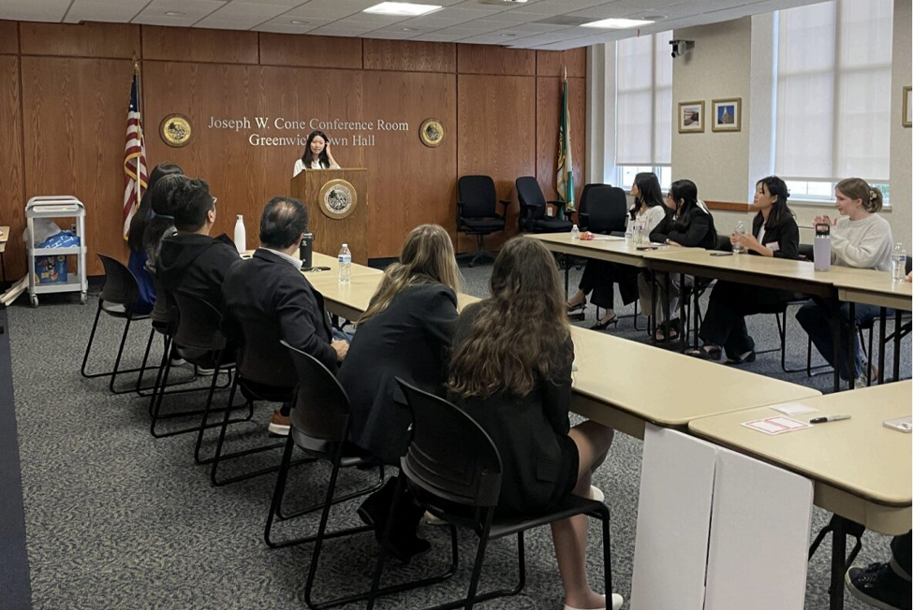

ADVOCACY
Youth Voice in Action
The most effective advocacy is done with youth — not simply for youth.
Youth Identify
Issues
→
Explore
Solutions
→
Present
Recommendations
→
Influence
Change
Raising Voices Youth Advocacy Showcase
A Greenwich Youth Services Bureau initiative led by the First Selectman's Youth Commission.
Connecticut Youth Services Association • Understanding ACUs
20

Slide 21
ADVOCACY
Effective Advocacy
Effective advocacy is intentional. It is built on relationships, informed by data, and strengthened by youth voice.
Effective Advocacy Requires:
Keeping Youth Voice at the Center
✓
Clear communication
Whether supporting an individual young person or working to improve systems, our effectiveness always comes back to relationships, credible information, strategy, and youth voice.
✓
Trusted relationships
✓
Credible information
✓
Strategic thinking
✓
A commitment to improving outcomes for youth
Connecticut Youth Services Association • Understanding ACUs
21

Slide 22
ADVOCACY • LIVE POLL
Looking Ahead: Strengthening Your Advocacy
Which area of advocacy would you most like to strengthen in your YSB over the next year?
Individual Advocacy
Systems Advocacy
Public Policy
Community Awareness
Funding & Resource Development
I'm not sure yet
📊 Launch the closing Zoom poll
Advocacy looks different in every community — that's one of the strengths of our YSB network.
Connecticut Youth Services Association • Understanding ACUs
22

Slide 23
Administrative Core Unit • Function 5
Management & Administration
Leading YSB operations with accountability, transparency, and strategic vision.
23

Slide 24
MANAGEMENT & ADMINISTRATION
Core Components
Strategic planning and goal setting
Conducted internally or with a consultant — annually, or as long-term 3-, 5-, or 10-year plans.
Fiscal oversight and budgeting
Led by the Director and/or Board to ensure responsible spending, grant management, and appropriate use of funds.
Staff supervision and development
Support staff in their roles with regular evaluation and professional growth opportunities.
Policy development and compliance
Best practices, employee handbooks, mandated reporter training, and HIPAA compliance, among others.
Board governance and reporting
Build a strong process for onboarding and recruiting board and committee members.
Program evaluation and quality improvement
Use surveys, focus groups, and SWOT analysis to improve delivery and service.
Connecticut Youth Services Association • Understanding ACUs
24

Slide 25
MANAGEMENT & ADMINISTRATION
Additional Management Functions
Human resources and personnel management
Recruitment, background checks, benefits, payroll, grievance process, and time-off policies.
Technology and information systems
Equipment, email, secure networks, registration, records systems, and social media accounts.
Risk management and insurance
Proper liability coverage for staff, volunteers, board members, and property.
Facility management
From shared town spaces to a stand-alone building and its full upkeep.
Interagency coordination
Share resources and connect youth and families with other community organizations.
Professional development planning
Build PD plans for each staff role; share low-cost or free training with other YSBs.
Succession planning
Cross-train staff, identify future leaders, and plan ahead for retirements or leave.
Connecticut Youth Services Association • Understanding ACUs
25

Slide 26
MANAGEMENT & ADMINISTRATION
Leadership & Fiscal Oversight
1
Develop and monitor annual budgets
Often done within a finance committee or jointly with a town manager or finance department.
2
Ensure compliance with grant requirements
Track grant goals, ownership, needed data, budget spend-down, and report deadlines.
3
Maintain transparent financial reporting
Regular, accurate, and accessible reporting for town leadership and board members.
4
Build organizational culture and morale
Foster a supportive, inclusive culture and celebrate staff and organizational wins.
Connecticut Youth Services Association • Understanding ACUs
26

Slide 27
Administrative Core Units
Next Steps
23

Slide 28
GETTING STARTED
Where New Directors Should Start
1
Review your YSB's current ACU documentation
2
Assess strengths and gaps across all five functions
3
Meet with staff to understand existing processes
4
Create or update your ACU Hub with organized folders
5
Set short-term goals for your first 90 days
6
Connect with CYSA for technical assistance
7
Develop a 12-month improvement plan
Connecticut Youth Services Association • Understanding ACUs
28

Slide 29
DOCUMENTATION
ACU Documentation Tips
Create an “ACU Hub” — a central location with folders for each function.
Recommended Documentation
Meeting minutes and agendas
Community outreach logs
Grant applications and reports
Needs assessment data
Advocacy correspondence
Financial reports and budgets
Program evaluation summaries
Connecticut Youth Services Association • Understanding ACUs
29

Slide 30
Reflection
?
Which ACU function is your organization strongest in? Why?
?
Where do you see the greatest opportunity for growth?
?
What resources or support do you need to strengthen your ACUs?
?
How can you better document and communicate your impact?
?
What is one action step you can take this week?
Connecticut Youth Services Association • Understanding ACUs
31

Slide 31
RECAP
Putting It All Together
Five functions, one mission — strengthening outcomes for youth and families.
1
Community Involvement — Engaging local stakeholders and building partnerships
2
Research & Assessment — Using data to guide decisions and measure impact
3
Resource Development — Securing funding and sustaining operations
4
Advocacy — Championing youth needs at all levels
5
Management & Administration — Leading operations with accountability
Connecticut Youth Service Bureau Association • Understanding ACUs
32

Slide 32
GROUP DISCUSSION
Discussion Points
What resources or support do you need to strengthen your ACUs?
Share information about successful programming to foster collaboration among YSBs. Be sure to name your YSB when you share.
Connecticut Youth Services Association • Understanding ACUs
27

Slide 33
Thank You
Strong systems create stronger outcomes for youth.

